Slide 1
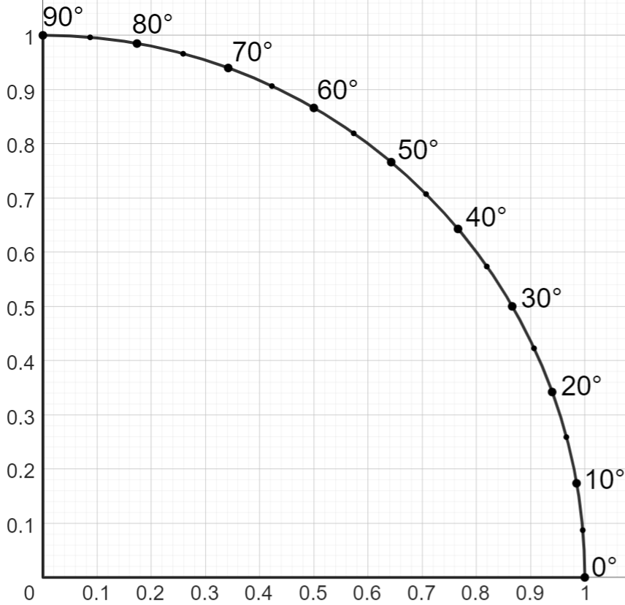
The unit circle
Task A: Introduction to sine and cosine
sin(θ)
The diagram shows the sector of the unit circle that lies in the first quadrant.
a) Use the diagram to complete the table.
cos(θ)
1)
θ° | 0 | 10 | 20 | 30 | 40 | 50 | 60 | 70 | 80 | 90
sin(θ)
0
0.17
0.34
0.5
0.64
0.77
0.87
0.94
0.98
1
Answers may vary slightly depending on how accurately they are read from the graph.
Use the link for an interactive version: unit circle in first quadrant🖇
b) What happens to the value of sin(θ) as the angle increases in this quadrant?
It increases. Its lowest value is 0 and greatest value is 1.
30°
c) Use your table to find the angle where sin(θ) = 0.5.
d) Use the diagram to find the angle where sin(θ) = 0.8.
53°
a) Use the diagram to complete the table.
2)
θ° | 0 | 10 | 20 | 30 | 40 | 50 | 60 | 70 | 80 | 90
cos(θ)
1
0.98
0.94
0.87
0.77
0.64
0.5
0.34
0.17
0
Answers may vary slightly depending on how accurately they are read from the graph.
Use the link for an interactive version: unit circle in first quadrant🖇
b) What happens to the value of cos(θ) as the angle increases in this quadrant?
It decreases. Its lowest value is 0 and greatest value is 1.
60°
c) Find the angle where cos(θ) = 0.5.
d) Find the value of θ where cos(θ) = sin(40°).
50°
e) Find the angle where cos(θ) = sin(θ).
45°

Slide 2
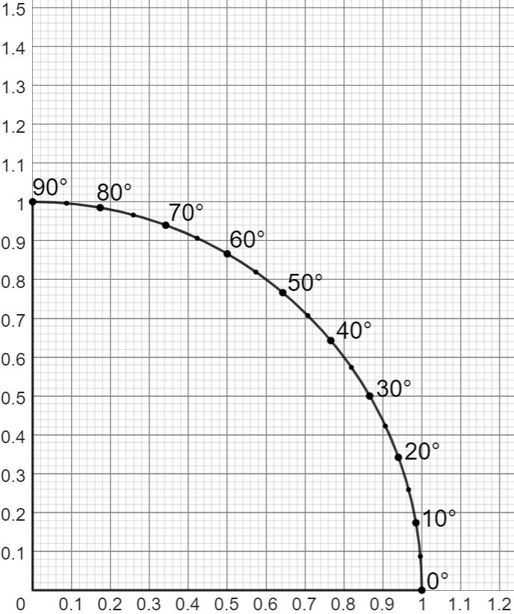
The unit circle
Task B: Introduction to tangent
1) The diagram shows the first quadrant of the unit circle.
a) Draw a tangent at x = 1.
b) Find the value of tan(35°)
0.7
c) Find the value of tan(55°)
1.4
d) Use the diagram to find the angle where tan(θ) = 1.
45°
e) Use the diagram to find the angle where tan(θ) = 0.5.
27°
Answers may vary slightly depending on how accurately they are read from the graph.
For an interactive version of the diagram, click the link: unit circle in first quadrant🖇
2) a) Complete the table.
θ° | 30 | 40 | 50
sin(θ)
cos(θ)
tan(θ)
0.5
0.64
0.77
0.87
0.77
0.64
0.58
0.84
1.19
Answers may vary depending on accuracy.
b) For each angle, divide the value of sin(θ) by the value of cos(θ). What do you notice?
The result of each division is approximately equal to the value of tan(θ).
Mathematics in Education and Industry
v2.3

